Slide 1
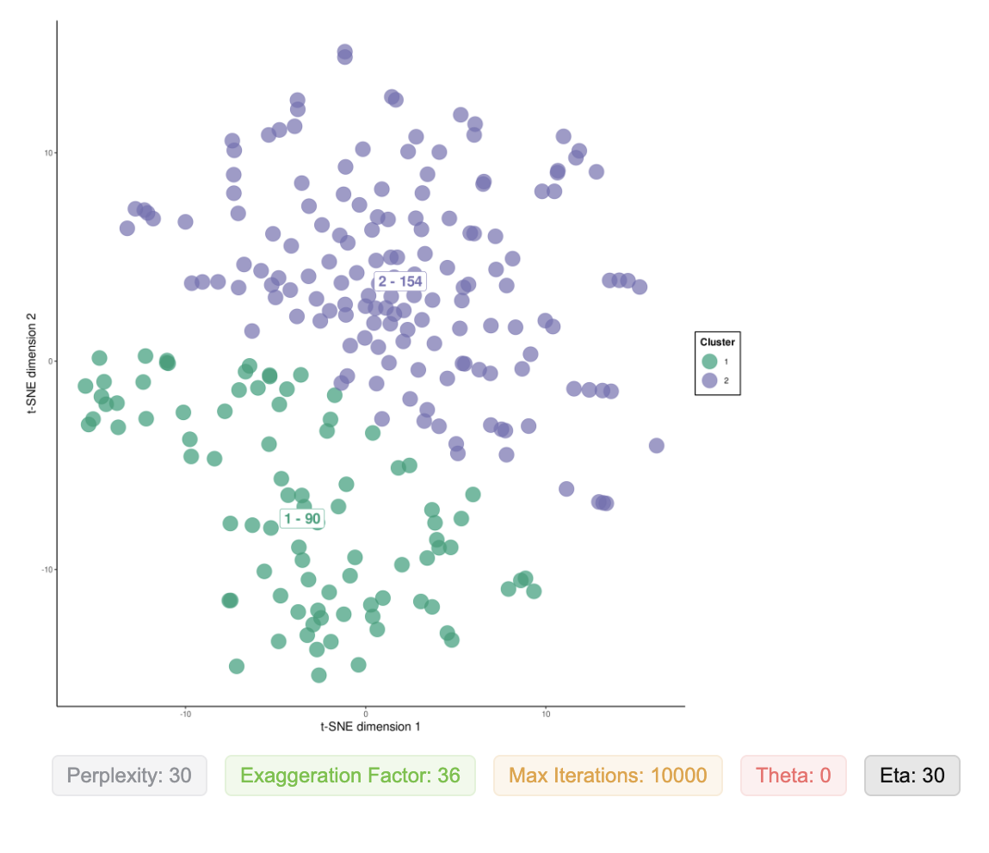
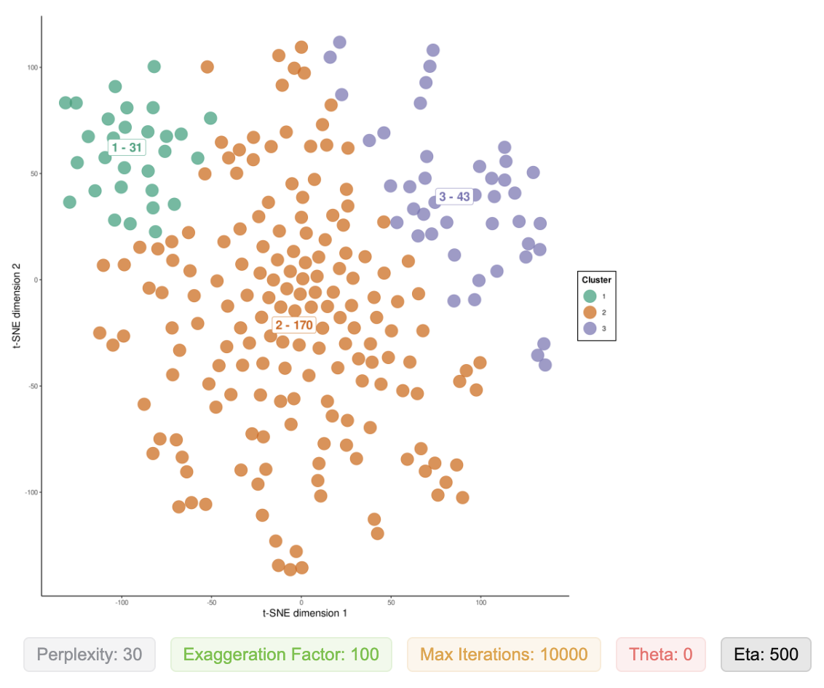
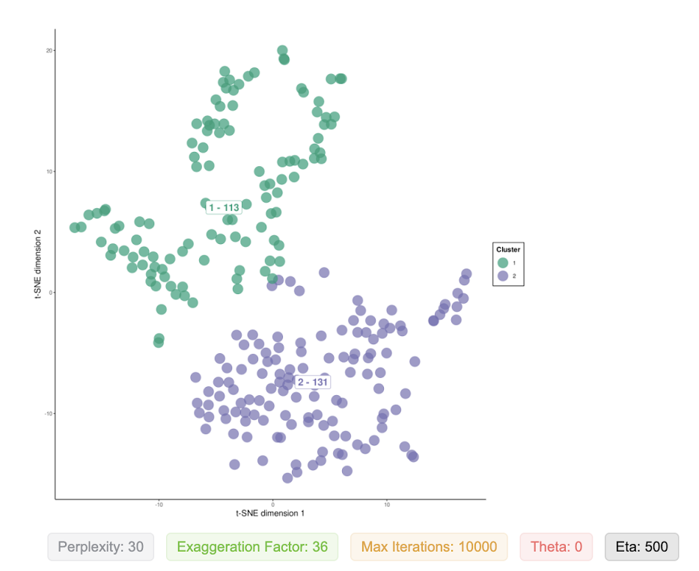
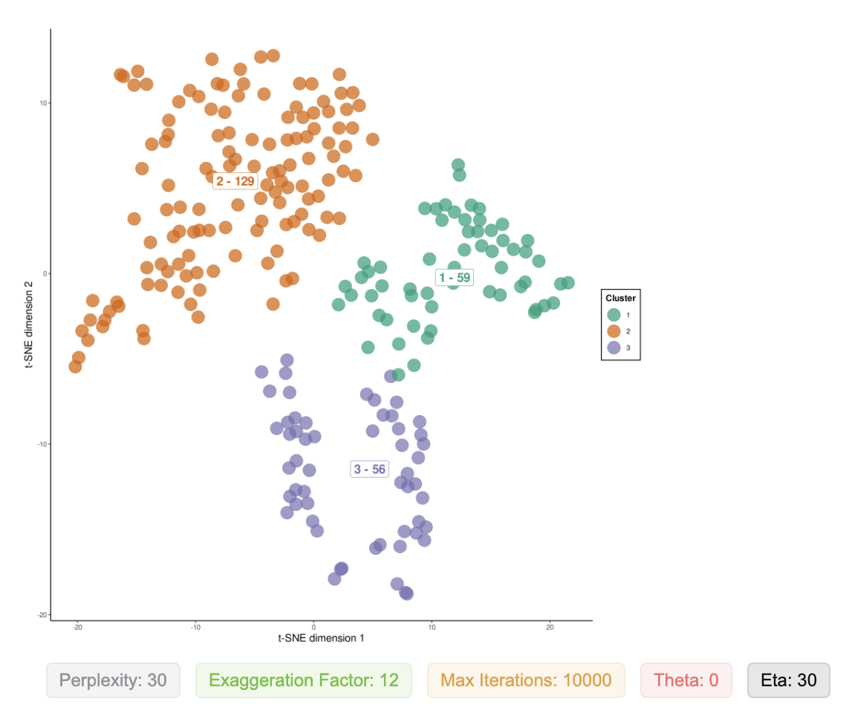
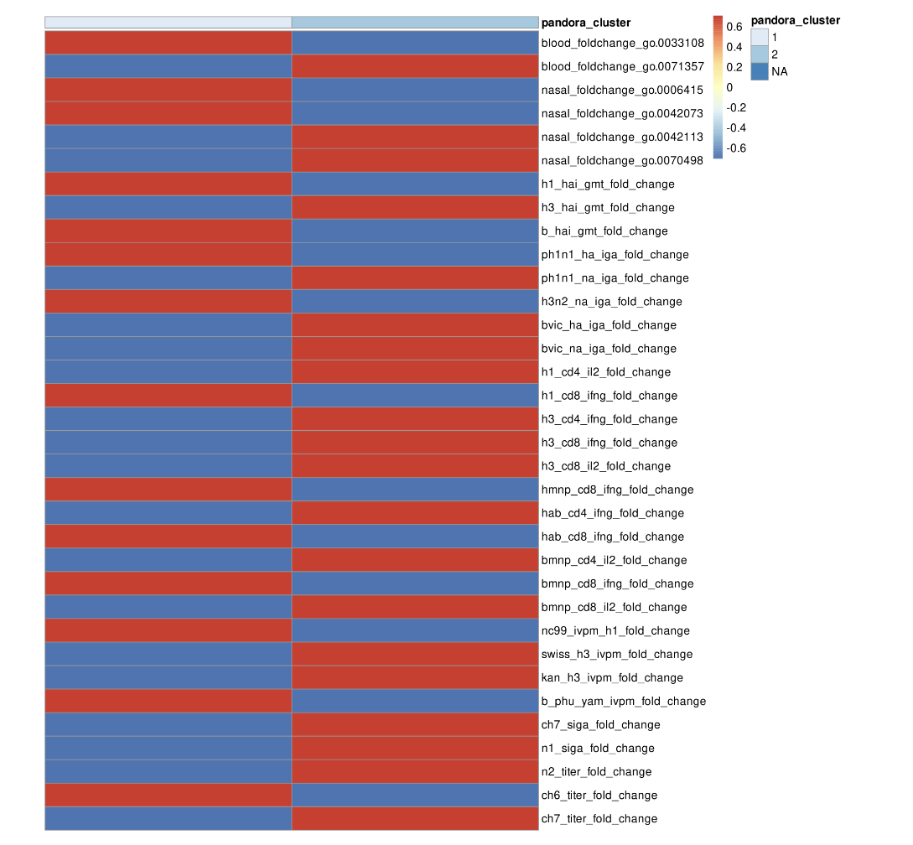
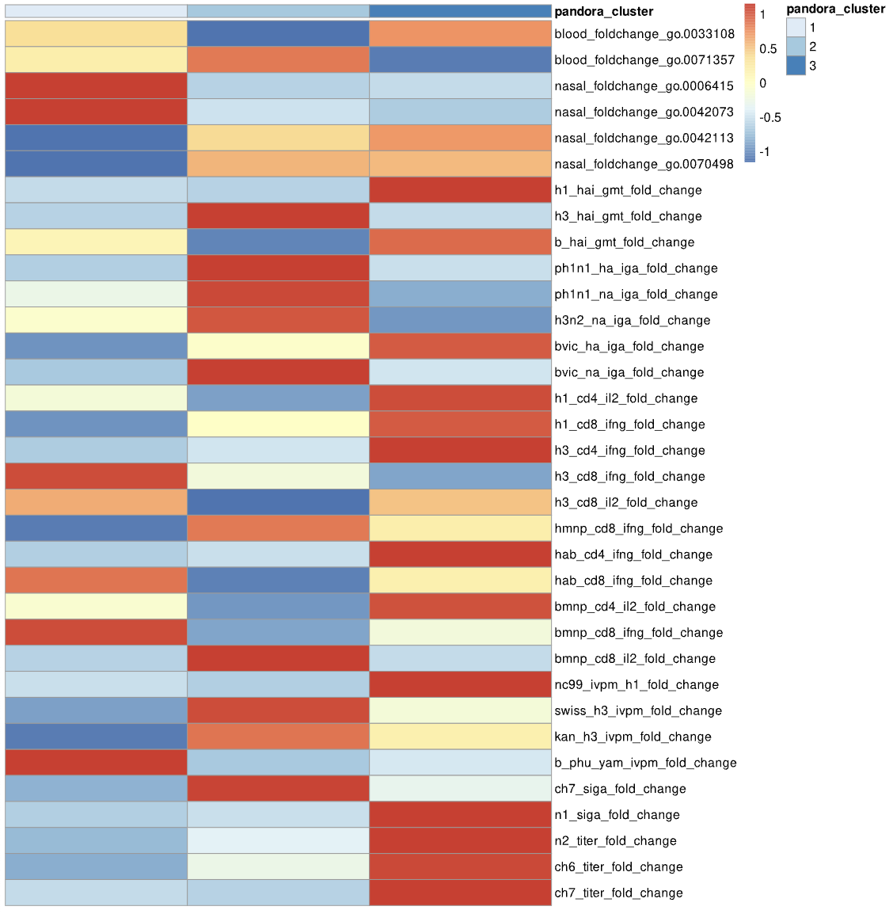
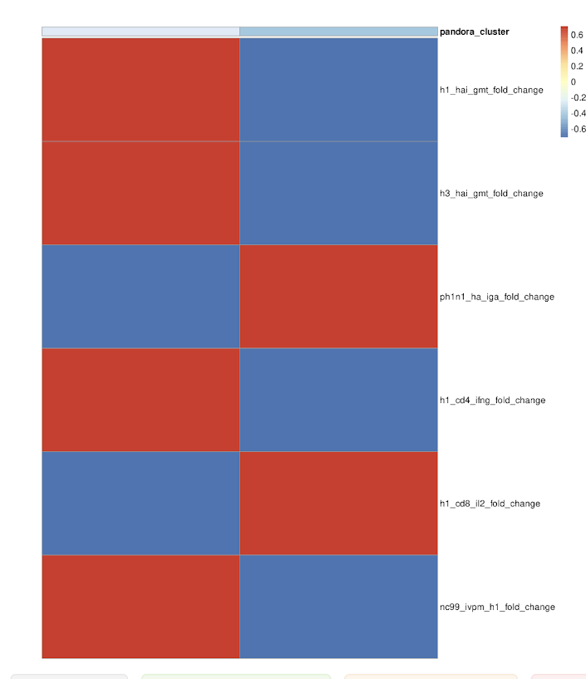
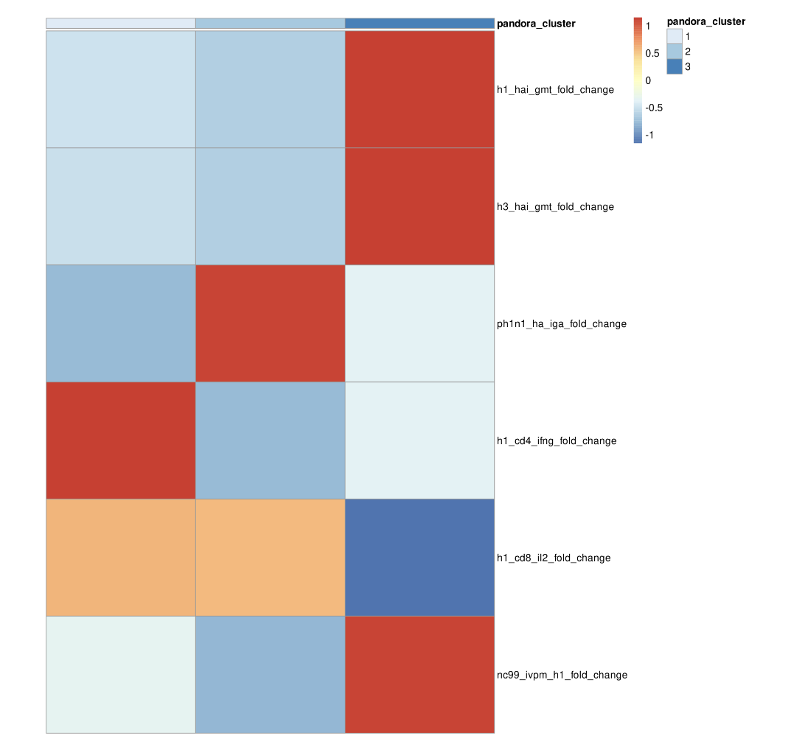
Team Matzinger - Group 5 Selena Halabi, Kewei Ye, Jordan Smiley, Lexi Wittstadt, and our pets!
Hypothesis: A normalized approach across variety of immunological variables is required to understand the overall immunological response to LAIV vaccines.
Solution: explore clustering with t-SNE using fold-change variables, and PANDORA!
Process:
Run t-SNE with the fold change variables to create clusters (four methods)
Reorganize model data set only include baseline variables and t-SNE clusters
Run predictive models of all the options with each cluster variable as the response using PANDORA
Evaluate the best model (especially predictive AUC)
t-SNE 1, all fold-change
Silhouette score: 0.36
t-SNE 2, all fold-change
Silhouette score: 0.27
t-SNE 3, 6 fold-change
Silhouette score: 0.49
t-SNE 4, 6 fold-change
Silhouette score: 0.47
Best model: gbm with t-SNE 2 (Train AUC = 0.8176 , Predict AUC = 0.8956, Accuracy = 0.7119)
Future directions: an intermediate number of variables, 3 clusters to improve performance

